Slide 1
Spring Introduction
Shruti

Slide 2
Agenda
1. Web application architecture
2. Monolithic & microservices
3. Intro to REST, GraphQL
4. Intro to Java Servlets
5. IOC & Dependency Injection
6. Blocking & Non-blocking web stacks

Slide 3
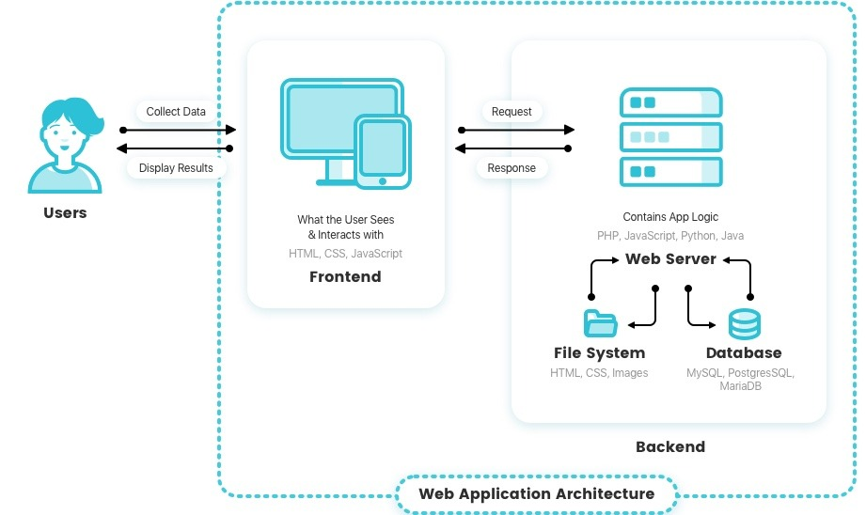
Web Application Architecture

Slide 4
Models of Web Application Components
One Web Server, One Database
Multiple Web Servers, One Database
Multiple Web Server, Multiple Databases
Application Services

Slide 5

One Web Server, One Database

Slide 6
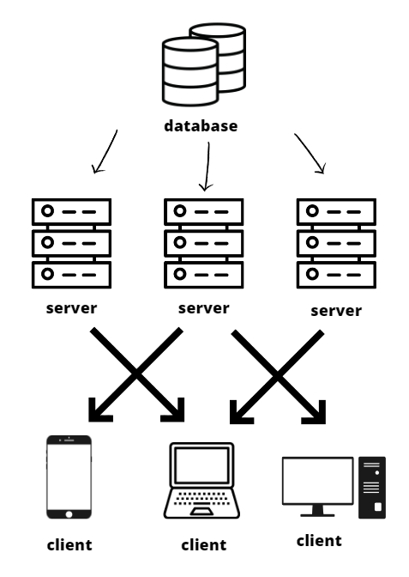
Multiple Web Servers, One Database

Slide 7
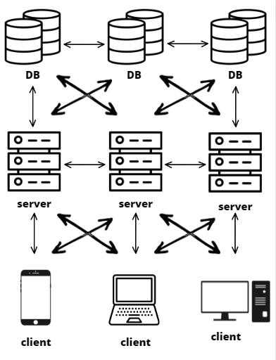
Multiple Web Server, Multiple Databases

Slide 8
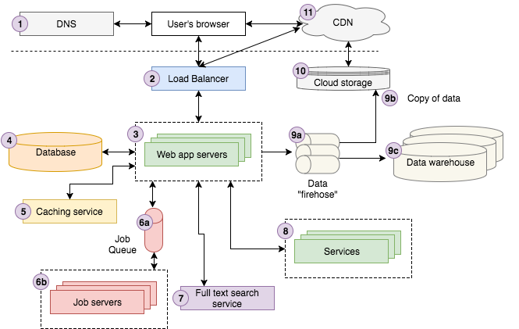
Modern web application architecture overview

Slide 9
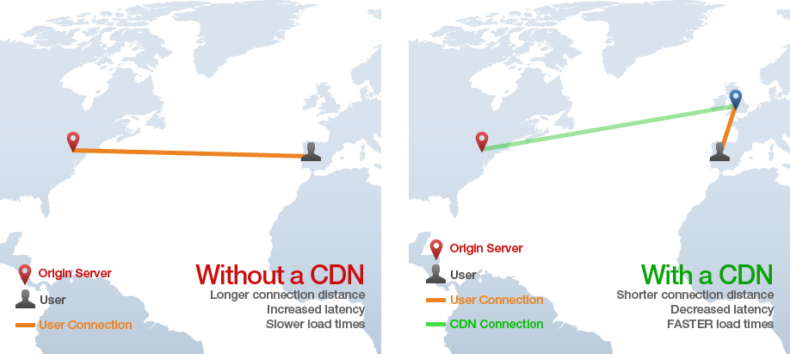
Content Delivery Network (CDN)

Slide 10
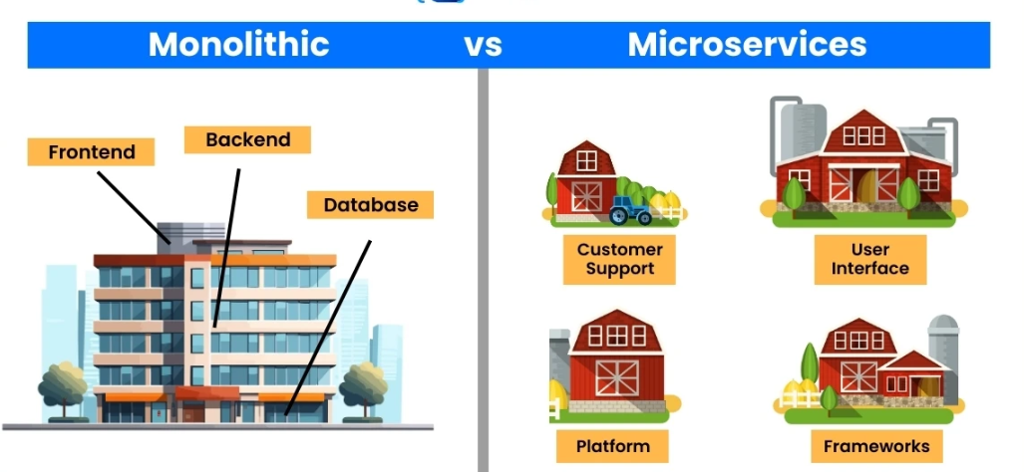
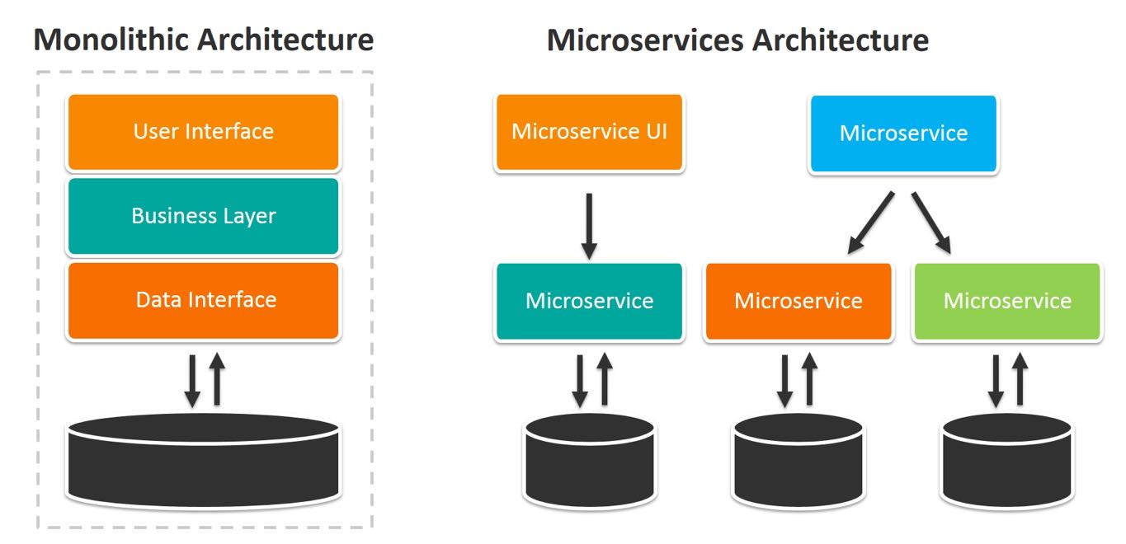
Microservices vs. Monolithic Architectures

Slide 11
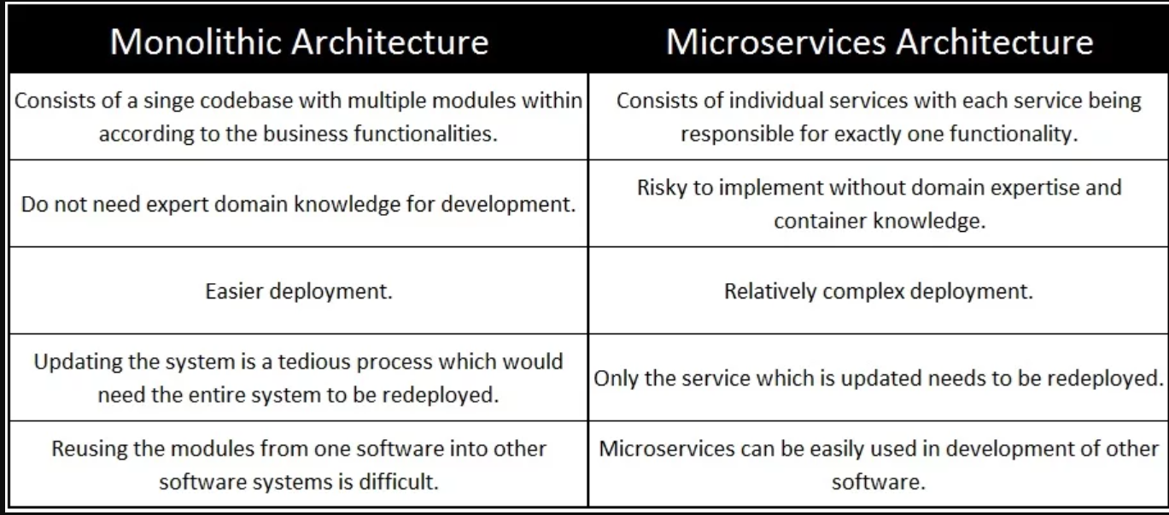
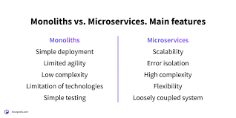

Slide 12
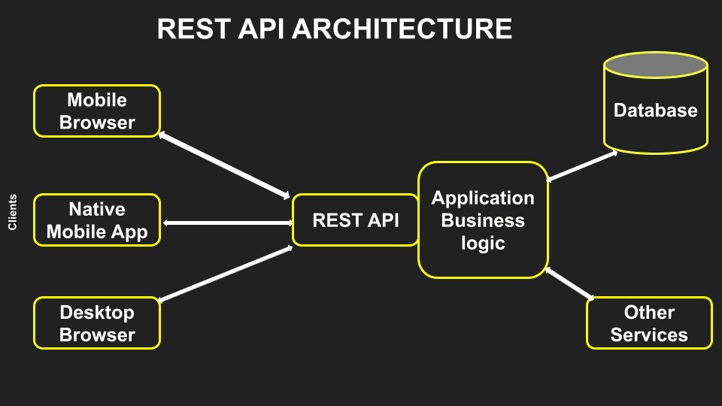
REST API
REST API (also called a RESTful API or RESTful web API) is an application programming interface (API) that conforms to the design principles of the representational state transfer (REST) architectural style.
Stateless client-server communication, meaning no client information is stored between get requests and each request is separate and unconnected.

Slide 13
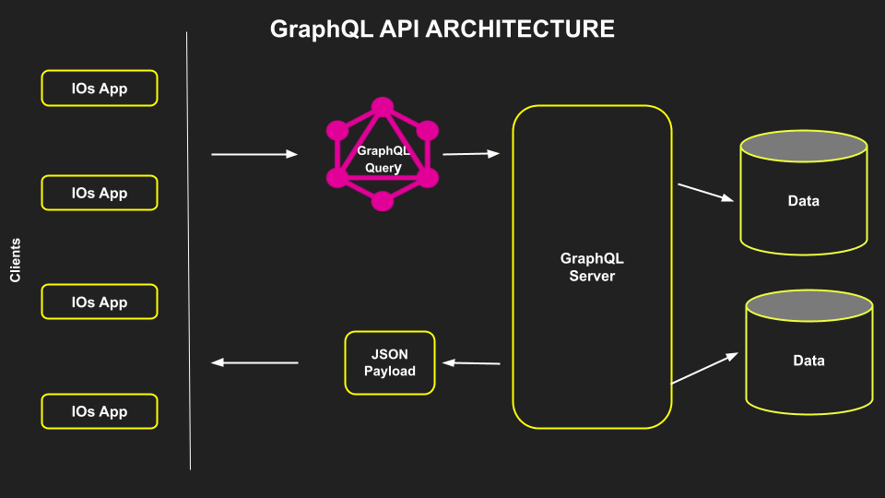
GraphQL
GraphQL is an API query language as well as a runtime for answering those queries with existing data. It also comes equipped with powerful tools for handling even the most complex of queries.
GraphQL’s central feature is its ability to request and receive only the specific data requested — nothing more. This makes it much simpler to scale your APIs along with your app.
The most exciting part of GraphQL is its ability to provide you with all the data in one endpoint.

Slide 14
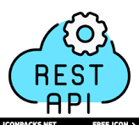
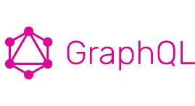
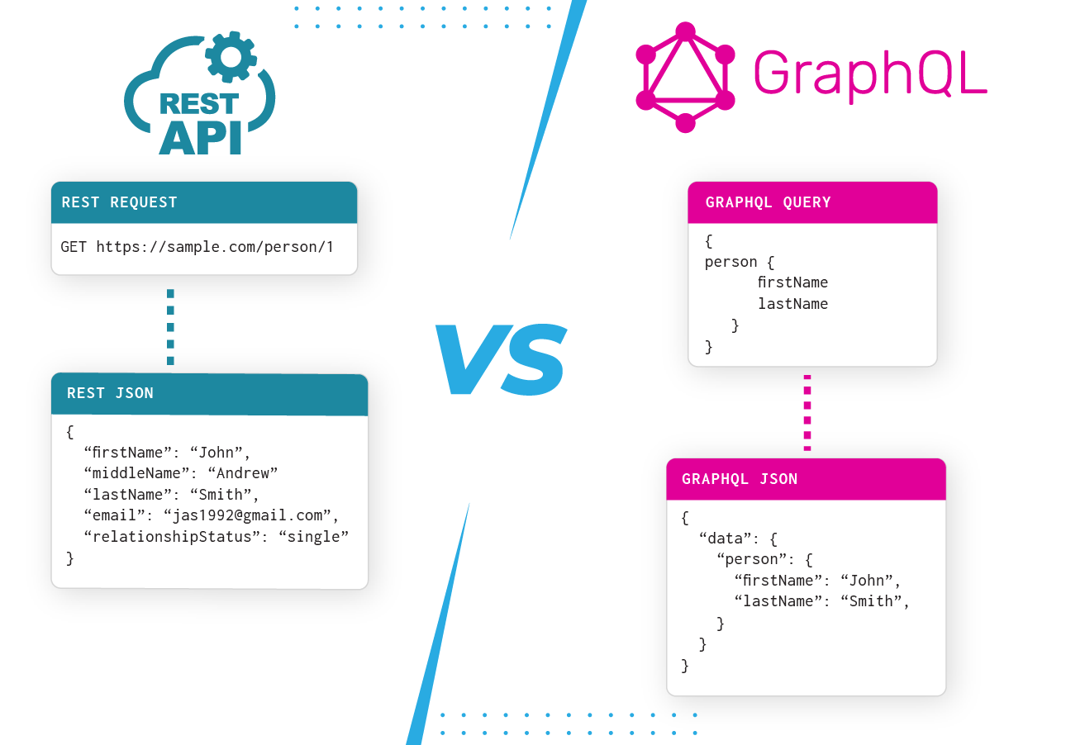
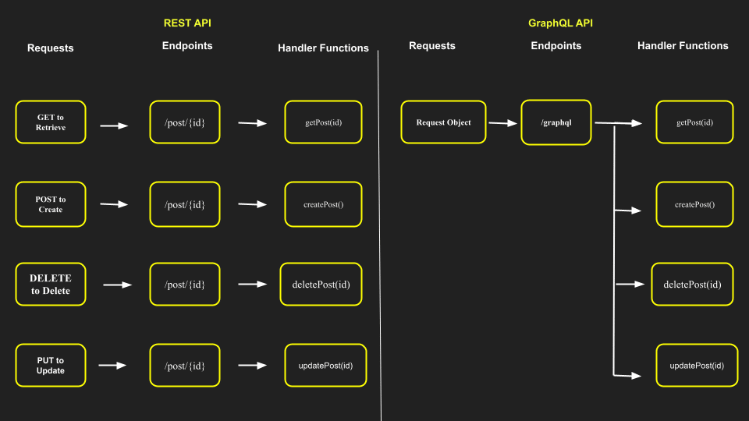
REST and GraphQL

Slide 15
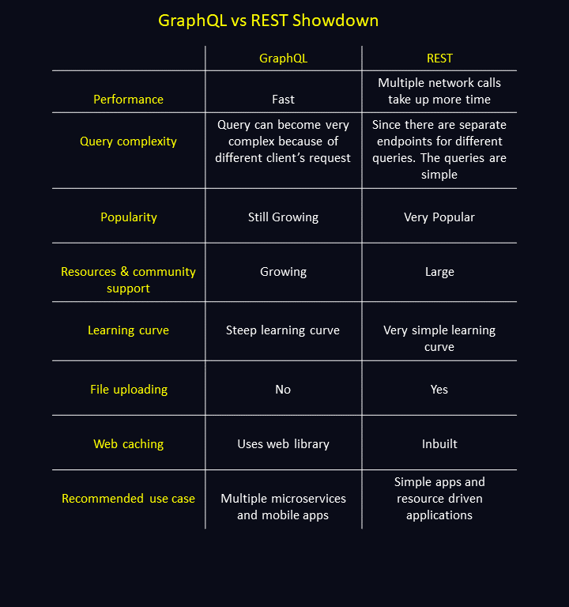

Slide 16
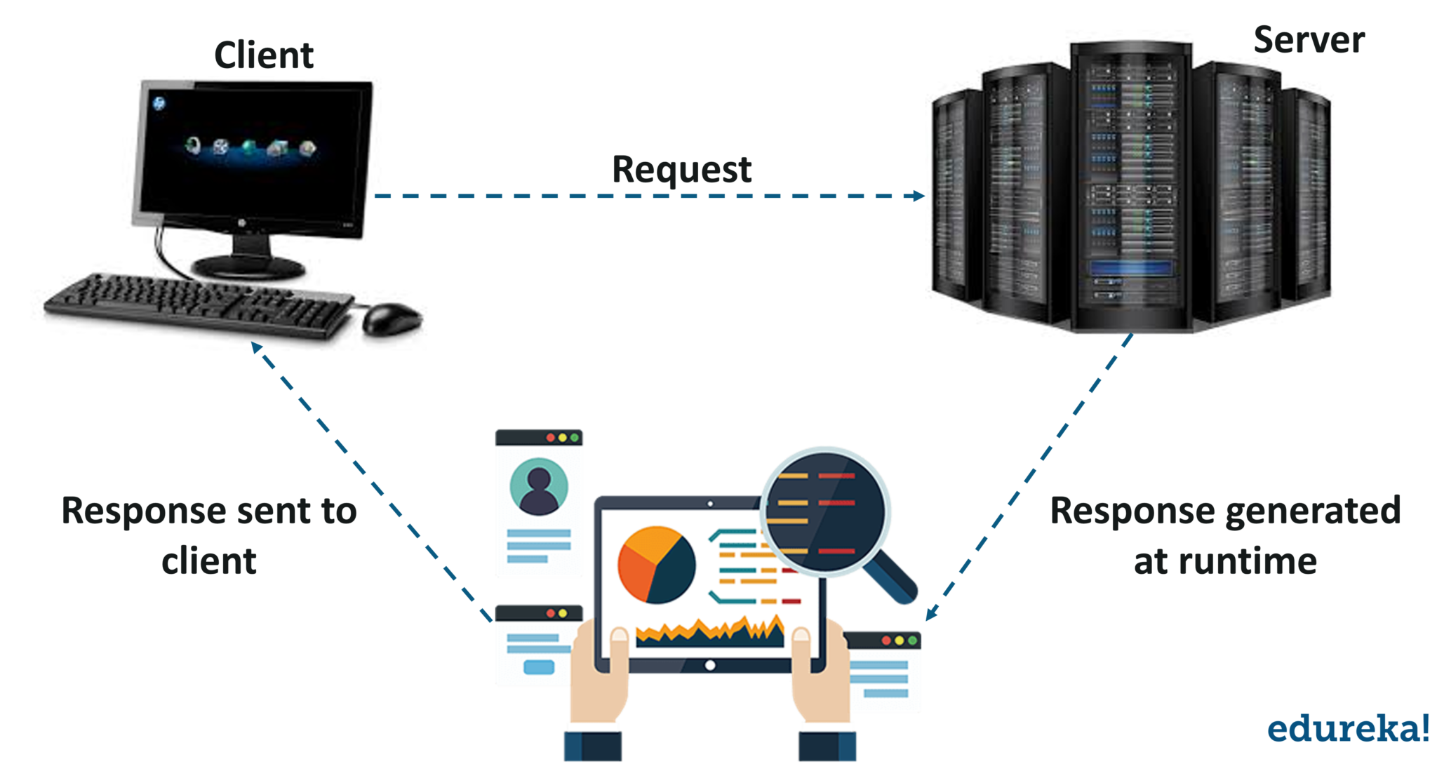
Java Servlet
Servlet is a server-side Java program module that handles client requests and implements the servlet interface. Servlets can respond to any type of request, and they are commonly used to extend the applications hosted by web servers.

Slide 17
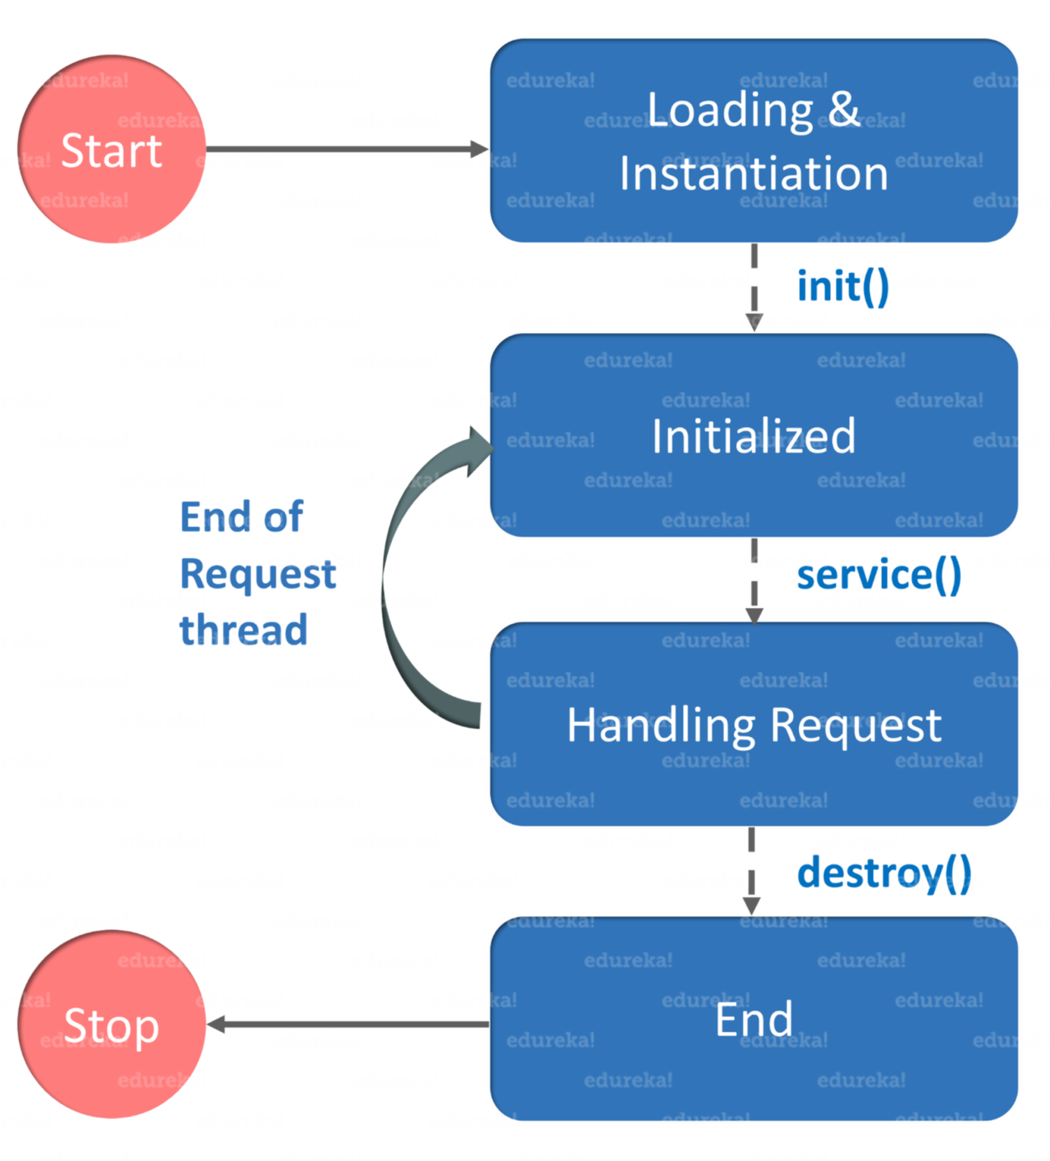
Servlet Life Cycle
Loading a Servlet
When a server starts up, the servlet container deploy and loads all the servlets.
Initializing the Servlet
Next, a servlet is initialized by calling the init() method. Servlet.init() method is called by the Servlet container to notify that this Servlet instance is instantiated successfully and is about to put into service.
Request handling
Then, servlet calls service() method to process a client’s request and is invoked to inform the Servlet about the client requests.
Destroying the servlet
Finally, a servlet is terminated by calling the destroy().
The destroy() method runs only once during the lifetime of a Servlet and signals the end of the Servlet instance.

